Slide 1
2.3. Supervised Learning
Supervised Learning & its Types

Slide 2







Supervised Learning
Supervised Learning is a type of ML where models are trained on labeled datasets — meaning each input has a known output.
Email spam filters
House Price Prediction
Image Recognition

Slide 3




Types of Supervised Learning
01
02
Classification
Regression
Used when the output is a category or label — for example, predicting if an email is spam or not spam.
Used when the output is a continuous numerical value — for example, predicting a house price or temperature.
123

Slide 4
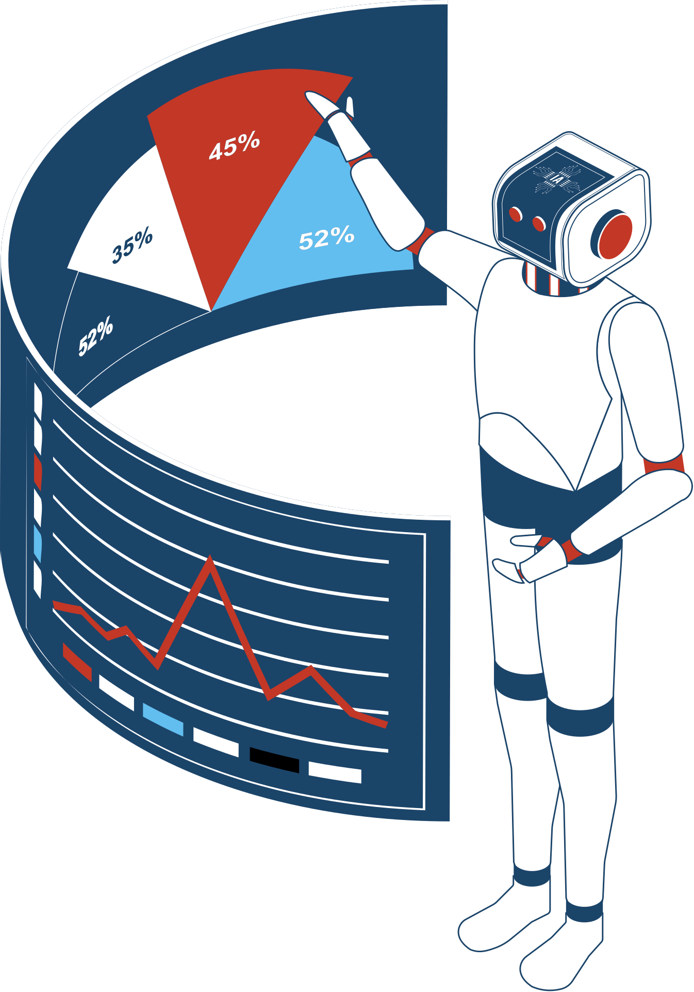
Classification Models
Logistic Regression
Decision Trees
Random Forest
Support Vector Machines (SVM)
K-Nearest Neighbors (KNN)
Naive Bayes

Slide 5

Regression Models
Linear Regression
Polynomial Regression
Ridge & Lasso Regression
Support Vector Machines Regression (SVM)
Decision Tree Regression
Random Forest Regression

Slide 6
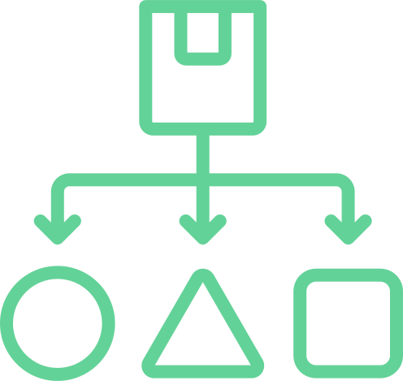
Applications
Classification
Email Spam Detection
Medical Diagnosis
Image Recognition
Loan Approval
123
Regression
House Price Prediction
Stock Price Forecasting
Sales Forecasting
Energy Consumption Forecasting

